Slide 2
Problem Statement
What opportunities exist for Big Mountain Resort to increase its revenue by at least $3.0M by the last quarter of next year by setting up better prices that will capitalize on its facilities and/or acquiring more equipment and services that will help support a better price?
Short Context
The resort has historically charged its price to a premium above the average level (at $81.00), resulting in the resort not being able to fully capitalize on the its prestige facilities.
Criteria For Success
Big Mountain Resort is able to generate at least 3 million dollars in profit before the last quarter of next year.

Slide 3
Recommendation and Key Finding
- We recommend to place a new price at $95.87.
- We did a simulation that the resort would have 1 more run, an increased vertical drop of 150 ft, and 1 additional chair lift (on the basis each visitor on average buys 5 day tickets), and the resort could support an increase of $1.99 per ticket and generate around $3.4M per year in revenue increase as a result.
- Key Finding: We have discovered that states do not play a factor when it comes to the price of the ticket. Certainly, this finding would justify that we could compare Blue Mountain Resort with other resorts that are not located in Montana.

Slide 4
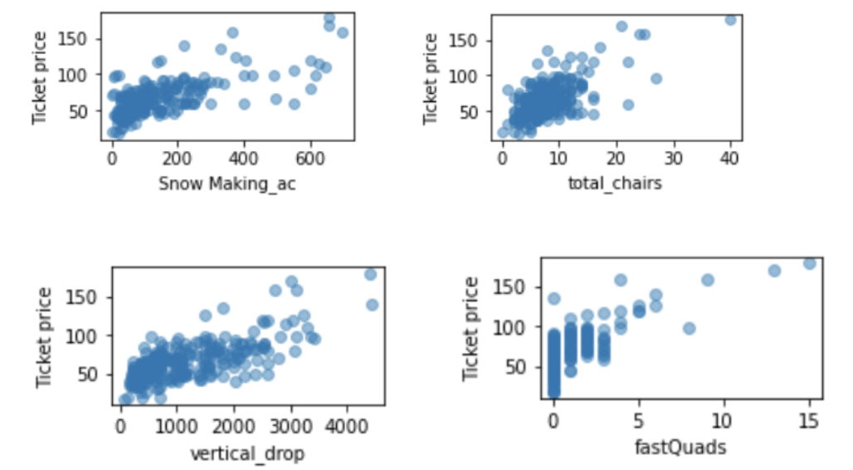
Modeling
From our scatterplots of features vs. price, we do discover that certain features, such as the four shown on the right, could help resort support a better ticket price, meaning generating more revenue.

Slide 5
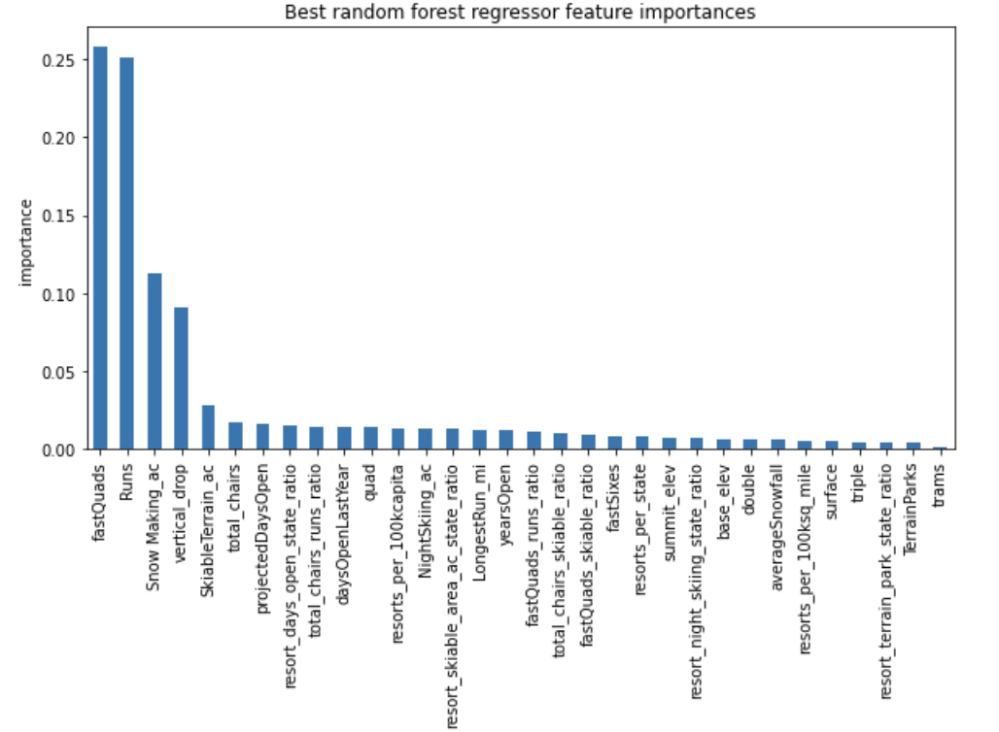
Modeling
From our random forest regressor model, we could tell that fast quads, runs, snow making, and vertical drops do play a big factor in terms of helping the resort support a better price.

Slide 6
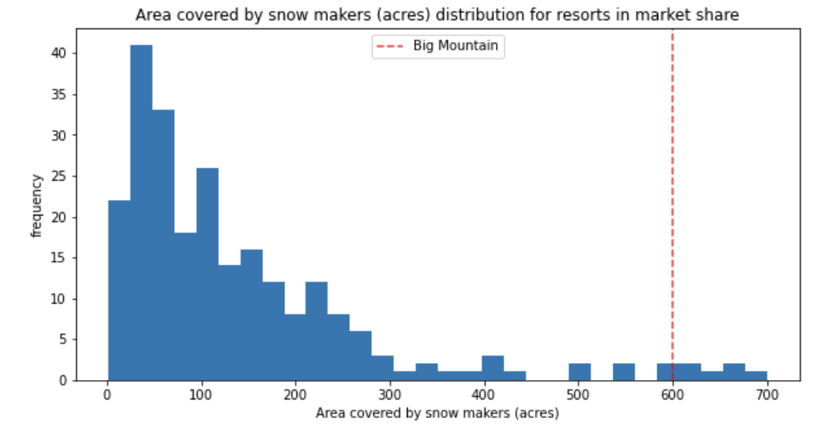
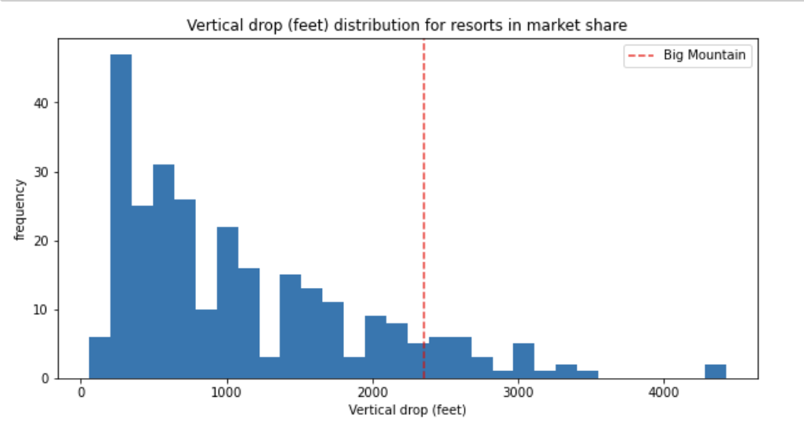
Modeling

Slide 7
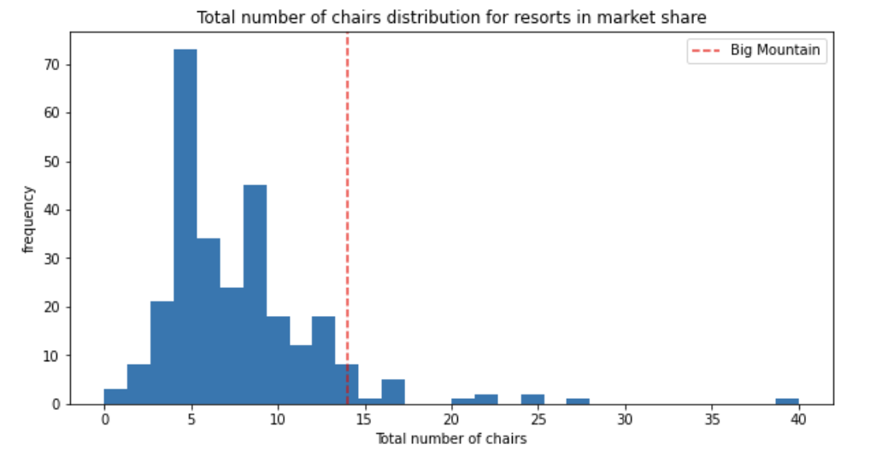
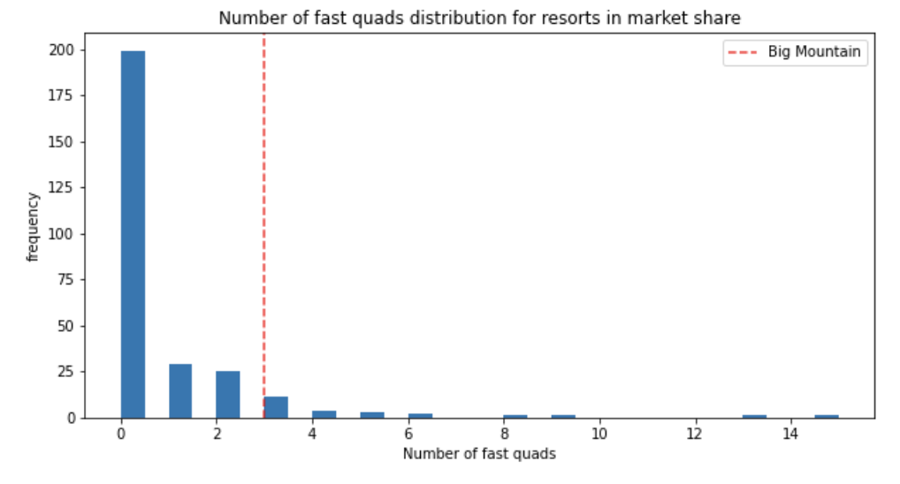
Modeling
From comparing Big Mountain’s number of chairs, number of fast quads, areas covered by snow, and vertical drop with the rest of the markets, we can see that Big Mountain does seem to be having a well above average standard compared with the rest of the resorts.

Slide 8
Summary
From our model, we found that Big Mountain Resort could have a ticket price of $95.87. It has a mean absolute error of roughly $10 dollars, which suggest that the current price of $81.00 is very underpriced, and should be replaced with the predicted new price.
With our simulation, it seems that having more chairs, increasing vertical drops, and more runs together certainly would help Big Mountain Resort to have a higher ticket price that would be supported by its facilities. Consequently, generating more profits that could cover the operational costs within a few years.

